Slide 1
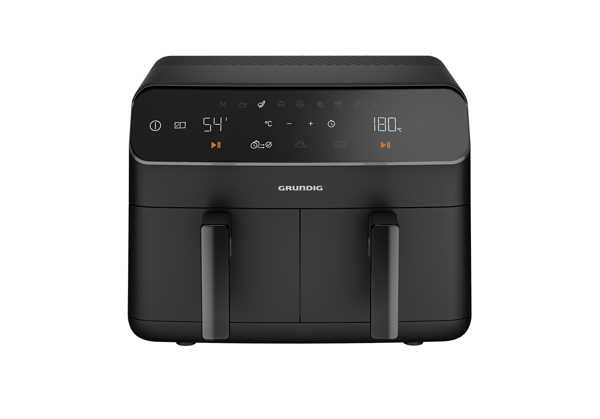
AIRFRYER
SDA
  Product Range 2023
4,25 L X 2 capacity
Low-fat and gentle preparation of food with little or no oil thanks to hot air
Removable non-stick basket
Smart finishing program; serves both foods at the same time
FRY 8320 (GMS8060)
Low-fat and gentle preparation of food with little or no oil thanks to hot air
Capacity: 2 x 4,25L (Total 8,5L)
2400 W power
Plastic body with decoration and wide touch screen
Smart finishing program; serves both foods at the same time
Match cooking program; easily copy settings across both zones
Al-Teflon coated inner pot material
Removable non-stick basket
Overheat protection
Keep warm function
Present Manual, Defrost, Reheat, Dehydrate, Air Broil,
Bake, Roast, Grill, Skewers
With cooking rack, grill and Dryer accessories
RRP NOK: 2499

